Slide 1
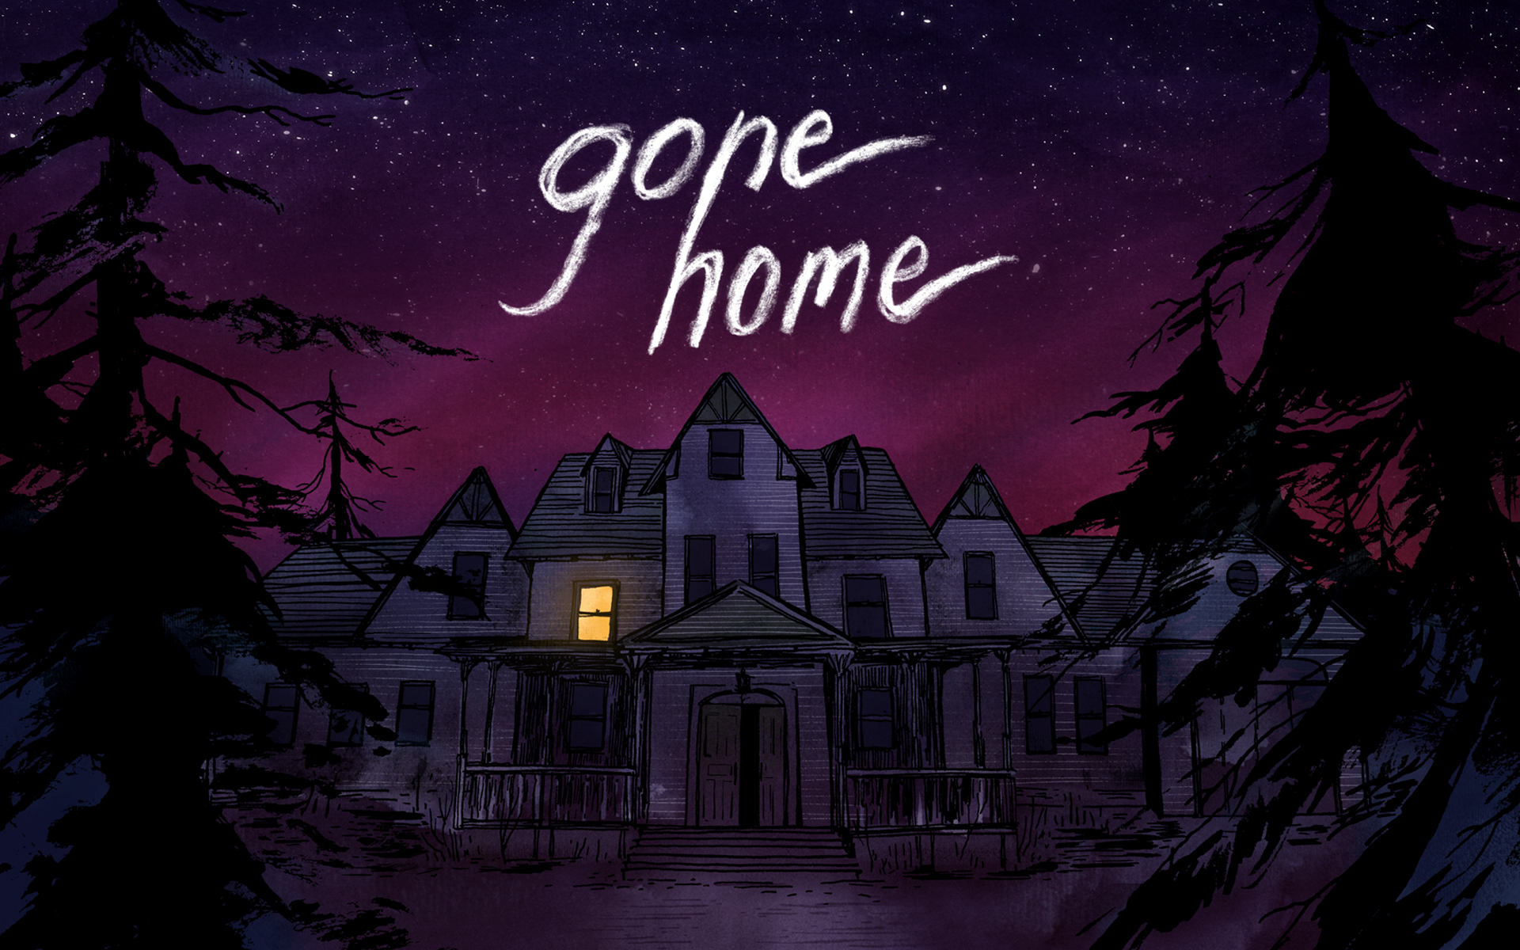
An Analysis by Kristen Smith

Slide 2
Gone Home Overview
Gone Home is a game that indirectly tells the story of a young girl named Sam and her family. The story opens with the player looking, through the eyes of Sam’s older sister who was gone for a year, at a letter that Sam left before her departure. As the game unfolds, the player is urged to wander through the house and look for letters, books, journals, and pictures in order to determine what happened to Sam.

Slide 3
Classical/Traditional Narratives vs. Gone Home
Order of Events:
  Most narratives have a tendency to be told in chronological order. The player finds out about the events as they happen.
Point of View:
  Narratives are generally told from the perspective of the main character. If a game is told through a first-person point of view, the player looks at the world through the eyes of the protagonist and can control the protagonists actions.
Setting
  Games often have multiple settings (house, school, street, etc.) Events happening in various places keeps the story entertaining or drives the plot.

Slide 4
Gone Home vs Traditional Narratives
Order of Events:
  This game is told entirely in the past, and, within that, the player finds out events in a very scattered order— especially since this order is not dictated by the game itself. Players could find out about Sam’s relationship with Lonnie long before they find out why the parents aren’t in the house, simply depending on which rooms they choose to venture into.
Point of View:
  This story is told indirectly from the third person point of view. The player’s role is simply to piece together what happened to Sam, rather than actually having any hand in changing the events. In fact, the game is set up so that the player has no hope of influencing the events, as everything has already happened.
Setting
  Games often have multiple settings (house, school, street, etc.) Events happening in various places keeps the story entertaining and tends to drive the plot.

Slide 5
Similarities
Gone Home is similar to traditional narratives in that both use objects, environments, or dialogue with other people to tell a story. There aren’t many games– excluding text based-- that simply say “Harry is a parent” if that is the subject of the story; rather, they’ll let the player stumble across a baby crib in Harry’s house or a family picture. Using this method allows the audience to have a more immersive experience.

Slide 6
Side Note
  If this game were written from the conventional perspective, the player would most likely be looking at the world through Sam’s eyes and experiencing the events with her. For instance, the player would go to school with Sam and watch her bullies torment her, watch Sam’s friendship with Lonnie unfold, etc. More importantly, the player would be able to influence the decisions made in the game.

Slide 7
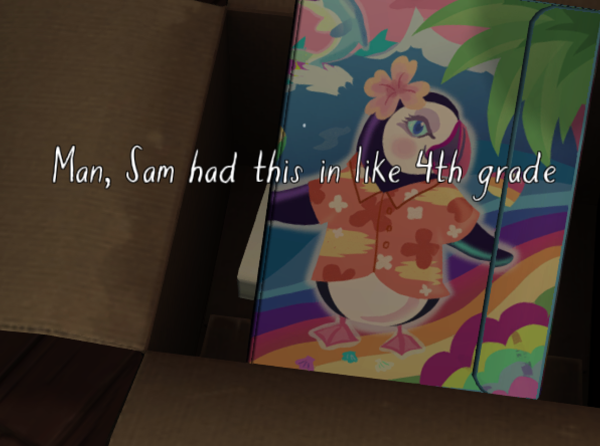
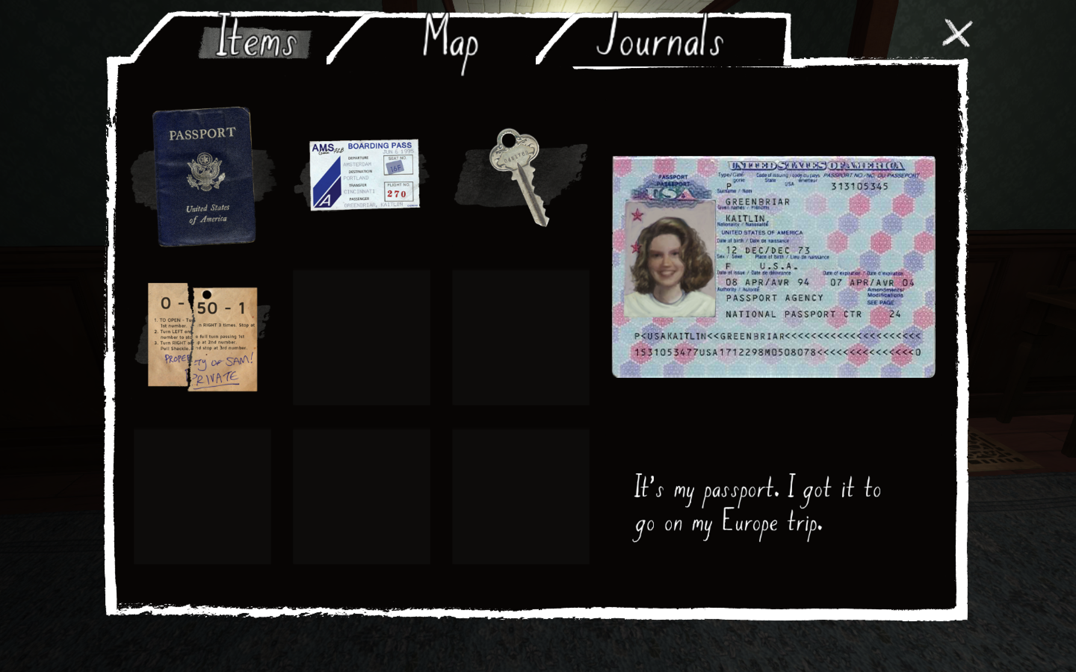
Additional Comments
Despite the fact that it was not integral to the story, the creators of the game added a distinct personality to Kaitlin-- the character through whose eyes the player is exploring the house. She’s a very sarcastic person, and is obviously a young adult (as evidenced by her thought process and the way she writes).

Slide 8
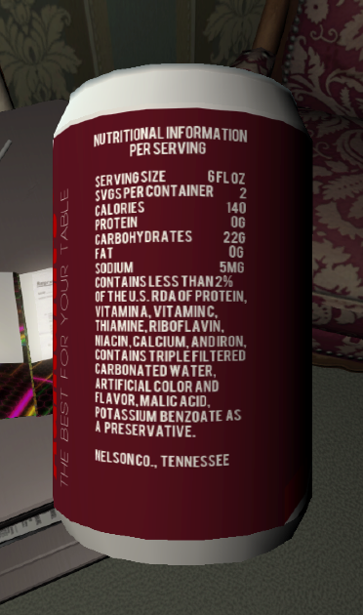
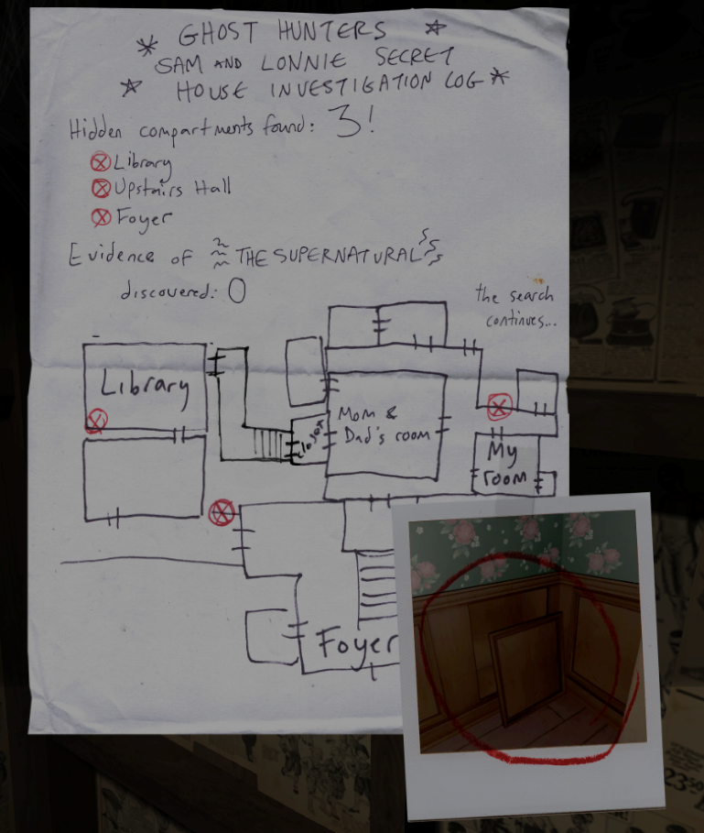
Additional Comments
The creators added a lot of detail to the game in general that enhances the experience, most notably:
Label on a soda can
Details on passport
Text that looks like someone’s handwriting rather than a computer generated font

Slide 9
Story or Game?
I would argue that Gone Home is more of a story than a game simply because its players are not actively changing the environment. Yes, they have the option of reading the story in whatever way they choose to, but their decisions do not affect the outcome of the game, as the story will inevitably end up the same because the events occurred in the past.

