Slide 1

Kevin Lee

Slide 2
Narrative Structure
Single setting–Oscar Masan’s house
First person–Kaitlin Greenbriar
Plot revealed through flashbacks
Limited interaction with a handful of objects
Main plot focuses around Samantha Greenbriar and her girlfriend
  Large amount of additional subplots that can be explored

Slide 3
Setting
Takes place entirely within the player’s house
  No transition animations, cutscenes, or other areas to explore
3 floors of rooms that can be explored with items that can be examined/manipulated
  High level of detail and objects that aren’t necessary to the plot–create a more immersive environment

Slide 4
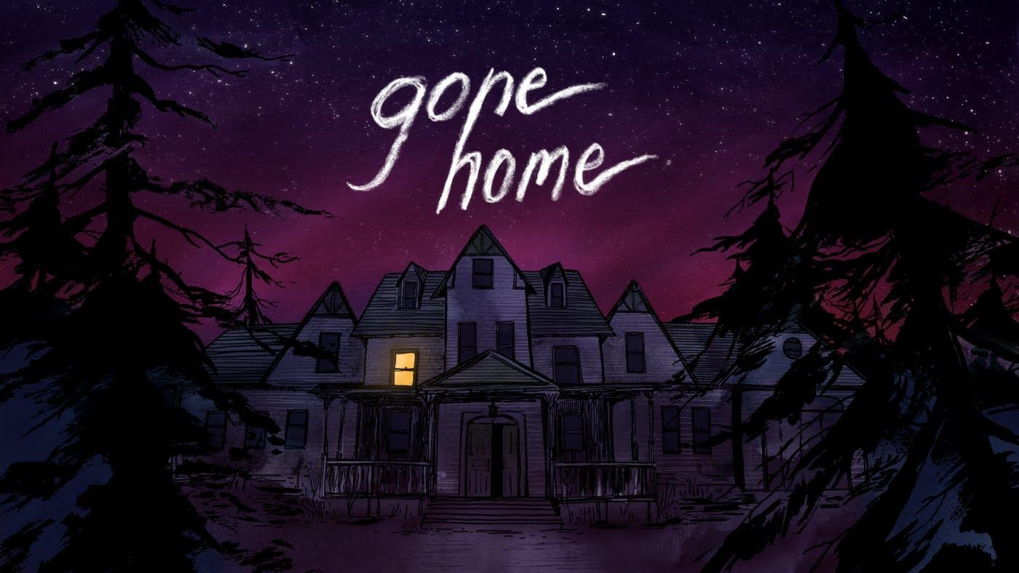
Exterior view of house where game takes place

Slide 5
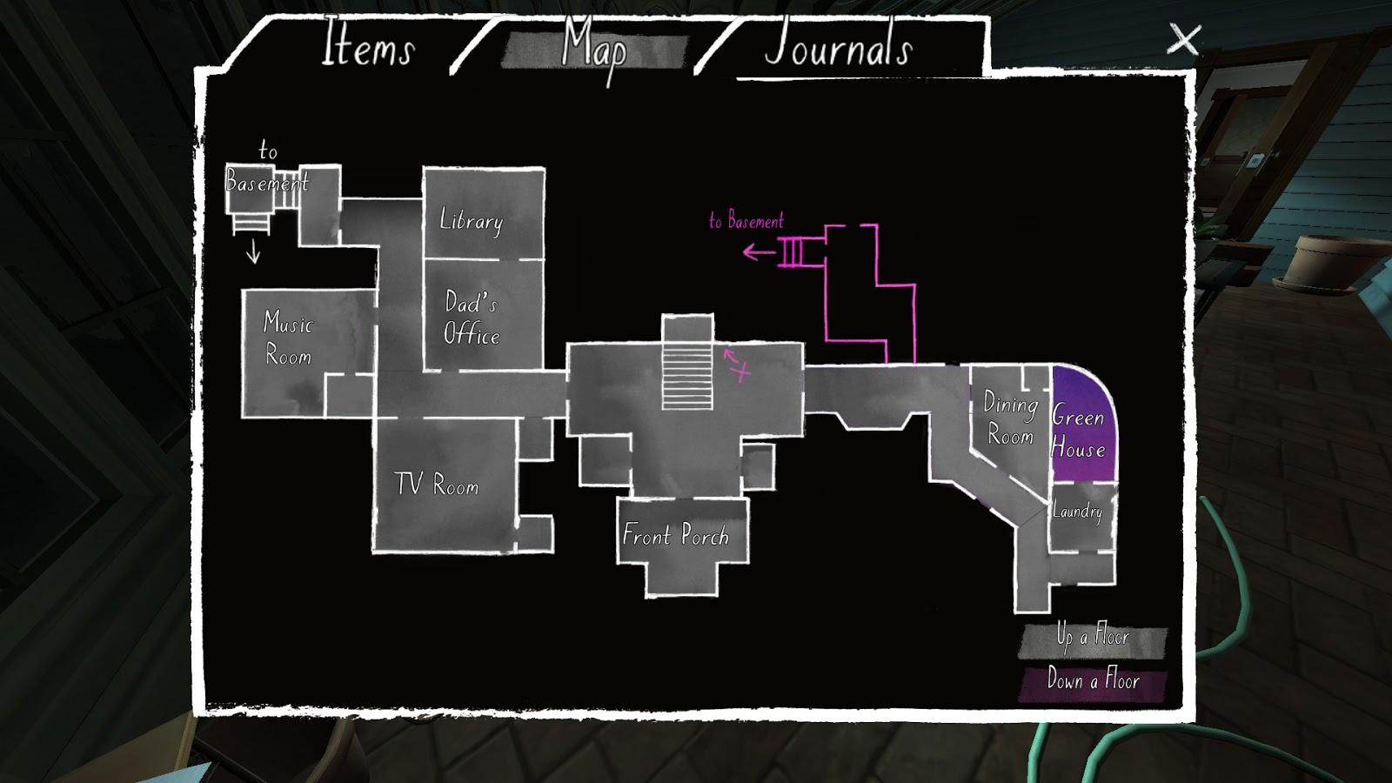
In-Game map of the first floor

Slide 6
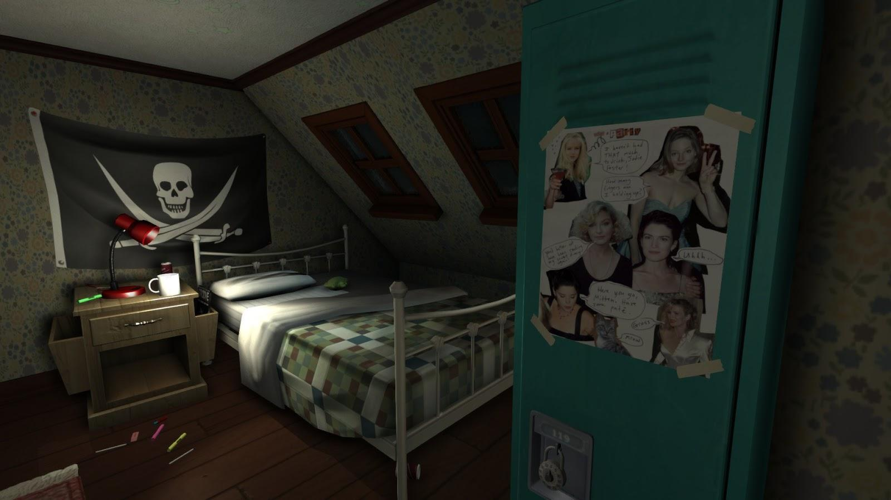
Room of Samantha Greenbriar, the protagonist and player’s sister

Slide 7
Character
Played entirely through the first-person perspective of Kaitlin Greenbriar
  Player is not the focus of the game
No other characters present
  All other characters only appear in pictures and journals
Protagonist–Samantha and her girlfriend Lonnie
  Never actually appear in the game

Slide 8
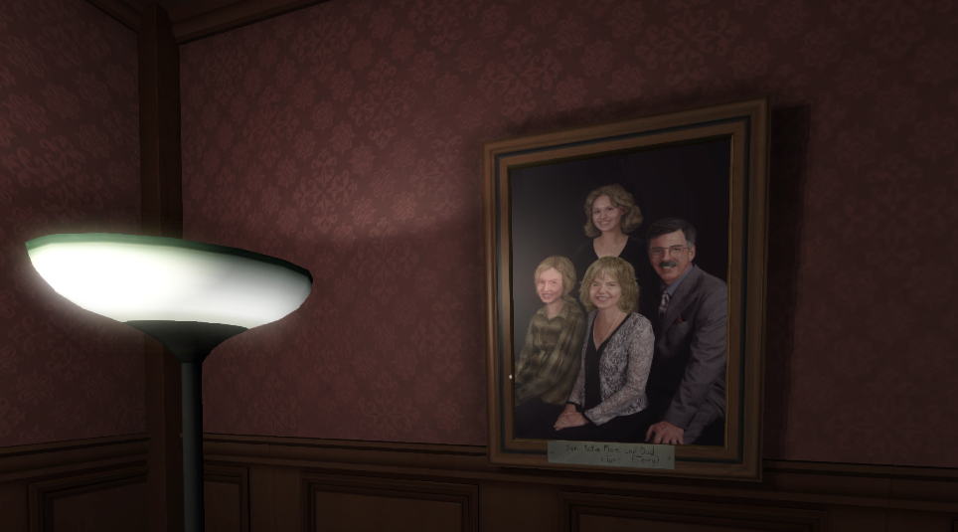
In game portrait of the protagonist’s family
Kaitlin (center bottom), Sam (left)

Slide 9
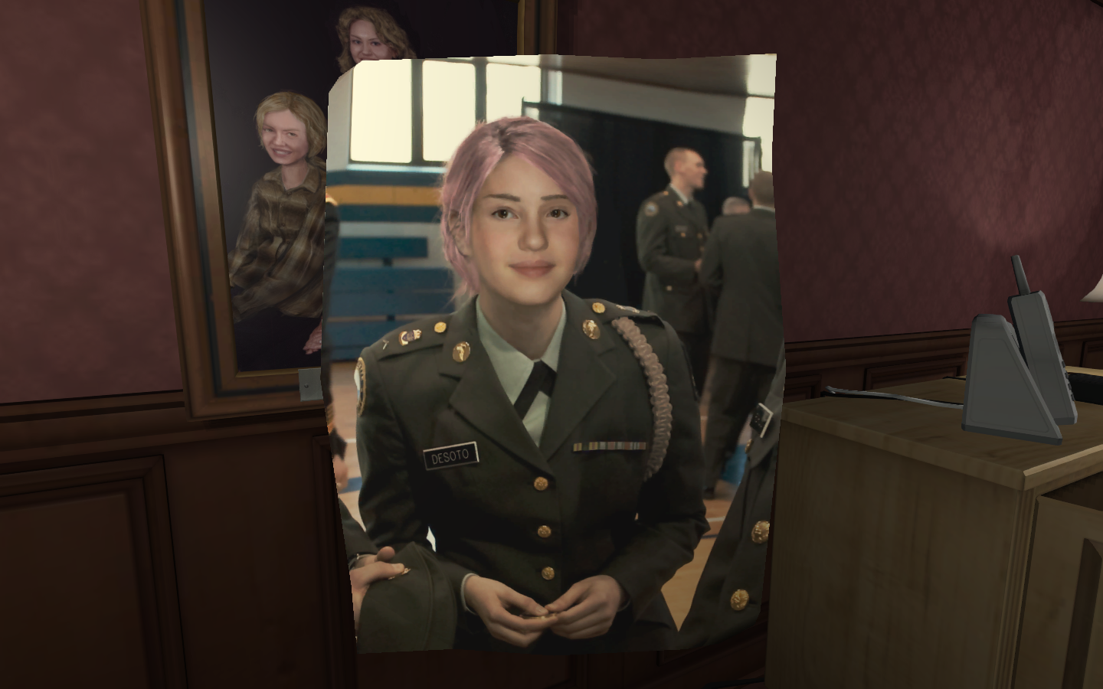
Lonnie as she appears in a photo in the game

Slide 10
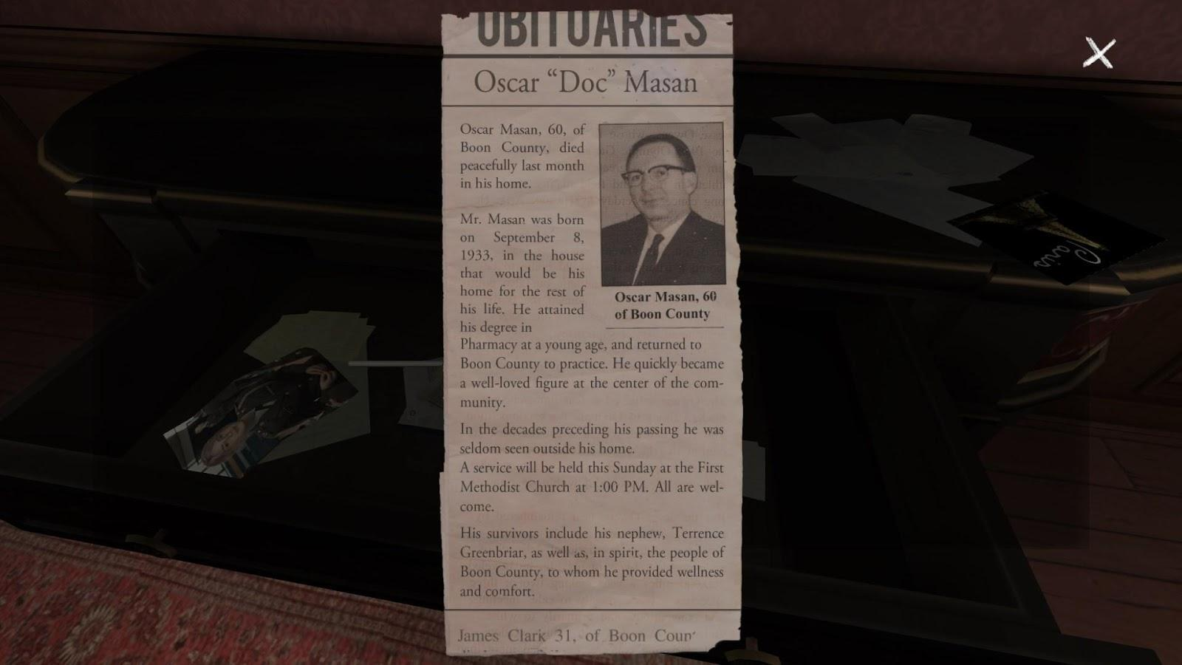
Oscar Mason, the protagonist’s crazy relative and previous owner of the house, as he appears in his obituary

Slide 11
Action
Interact with various objects/journals by moving around, picking them up, and reading them
  Similar to Amnesia and other first person explorer games
No shooting, talking, jumping, or other common actions
  Just moving and interacting

Slide 12
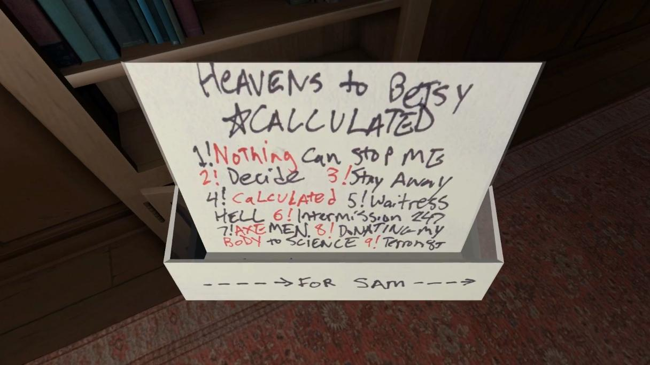
A cassette tape made for Sam by Lonnie, player can pick it up and turn it around to read everything that is written on it

Slide 13
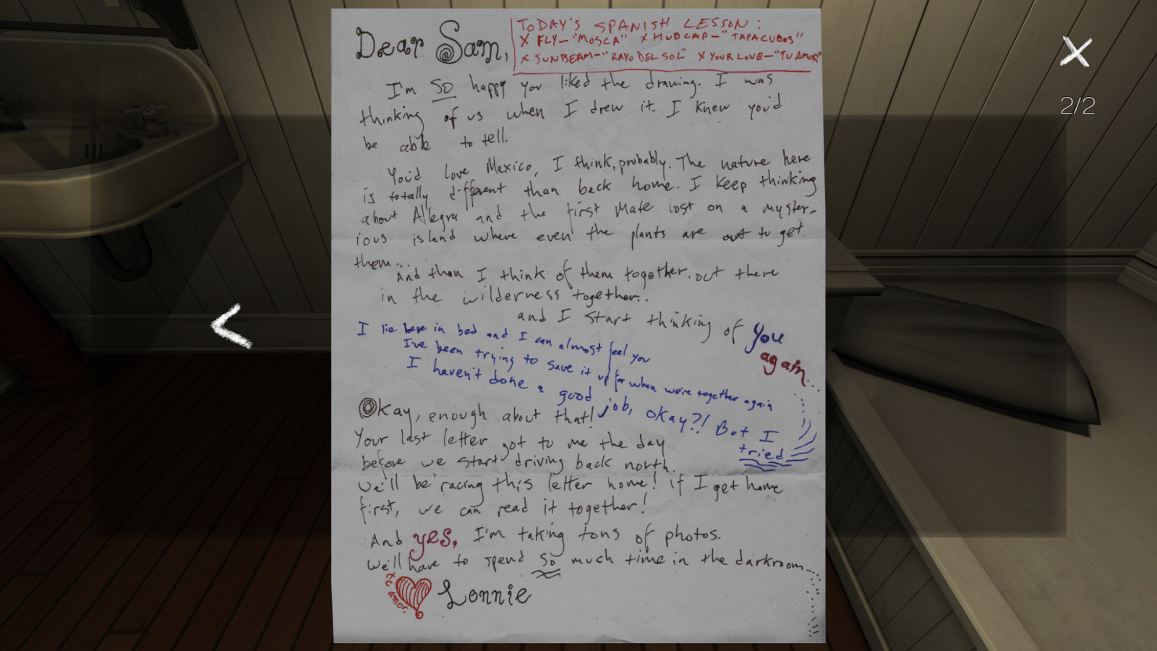
A letter written to Sam from Lonnie found in-game. Reading the letter gives the player insight into the characters and helps develop the plot

Slide 14
Story Time
The plot and main events of the game have already occurred
Events are revealed piece by piece through journal readings and in-game objects from a fixed point in time
Player generally experiences events in the same order that they occurred

Slide 15
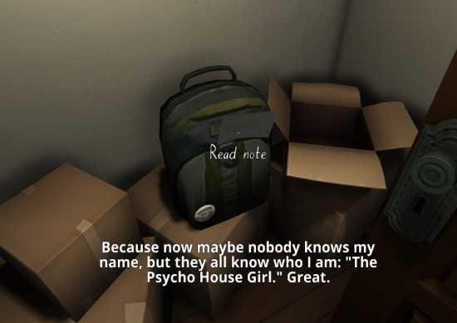
Transcript from one of Sam’s journals that are read by her voice in the game that reveal the plot to the player

Slide 16
User Participation
Player is more of a 3rd party observer to the plot rather than a highly involved character
Similar to an external narrator perspective
  Player’s character does not influence how the plot is perceived
Plot is unveiled rather than being acted out

Slide 17
Narrative vs Game vs Story
Has elements of all
  Depth and detail of a narrative; clear plot surrounding Sam and Lonnie’s relationship; same playability and user interaction of a video game
Creates a unique experience that immerses the user into the story through gameplay

Slide 18
Personal Reaction
Greatly affected by the game experience
Method of storytelling and interacting with the plot made it more engaging
Small details and subplots made the people/story seem much more real despite not being present
I could feel the characters’ emotions as they had to fight through discovery, family struggle, and separation

Slide 19
Success
Successfully demonstrates synergy between traditional and exploratory narrative
Plot, suspense, setting and other elements of traditional narrative all exist
Exploratory style reveals all these elements as the user uncovers them
Being a video game helped with the game’s success as an exploratory narrative

